Slide 1
CSC4-II: Continuous Vuln. Assessment & Remediation

Slide 2
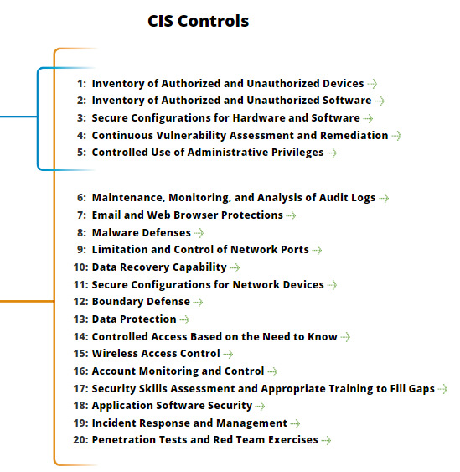
CSC4-II: Continuous Vuln. Assessment & Remediation
https://www.cisecurity.org/controls/

Slide 3
CSC4-II: Continuous Vuln. Assessment & Remediation
4.5: Deploy automated patch management tools and software update tools for operating system and software/applications on all systems for which such tools are available and safe.

Slide 4
CSC4-II: Continuous Vuln. Assessment & Remediation
4.5…: Patches should be applied to all systems, even systems that are properly air gapped.
4.6: Monitor logs associated with any scanning activity and associated administrator accounts to ensure that this activity is limited to the timeframes of legitimate scans.

Slide 5
CSC4-II: Continuous Vuln. Assessment & Remediation
4.7: Compare the results from back-to-back vulnerability scans to verify that vulnerabilities were addressed either by patching, implementing a compensating control, or documenting and accepting a reasonable business risk.

Slide 6
CSC4-II: Continuous Vuln. Assessment & Remediation
4.7…: Such acceptance of business risks for existing vulnerabilities should be periodically reviewed to determine if newer compensating controls or subsequent patches can address vulnerabilities that were previously accepted, or if conditions have changed, increasing the risk.

Slide 7
CSC4-II: Continuous Vuln. Assessment & Remediation
4.8: Establish a process to risk-rate vulnerabilities based on the exploitability and potential impact of the vulnerability, and segmented by appropriate groups of assets (example, DMZ servers, internal network servers, desktops, laptops).

Slide 8
CSC4-II: Continuous Vuln. Assessment & Remediation
4.8…: Apply patches for the riskiest vulnerabilities first.
A phased rollout can be used to minimize the impact to the organization.
Establish expected patching timelines based on the risk rating level.
END

